Slide 1
Ray tracing

Slide 2
Result
Single sphere
Triple sphere
Sphere and plane
Single triangle
Snowman

Slide 3
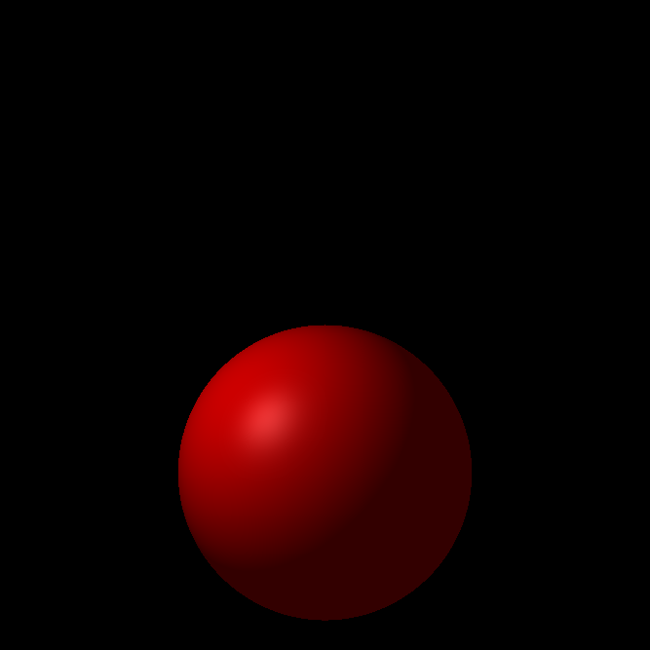
Single sphere
Figure 1. Single sphere ray tracing

Slide 4
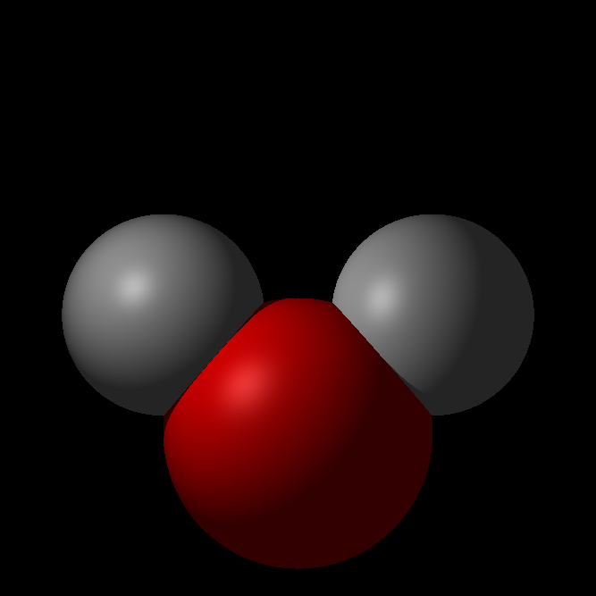
Triple sphere
Figure 2. Triple sphere ray tracing

Slide 5
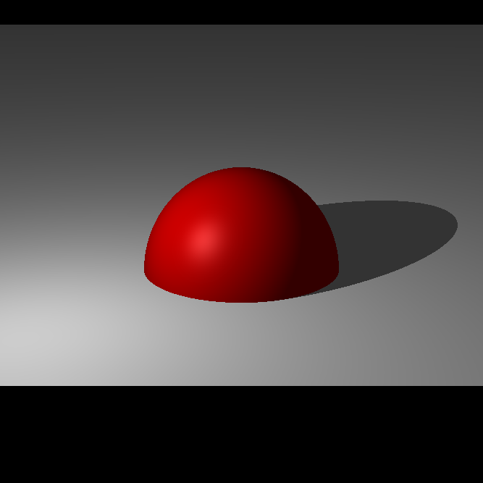
Sphere and plane
Figure 3. Single sphere and plane

Slide 6

Single Triangle
Figure 4. Single triangle ray tracing

Slide 7
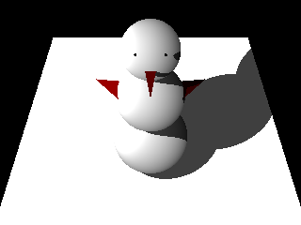
Snowman
Figure 5. Snowman ray tracing

Slide 8
Thank you!

